Slide 1
新產品焦點 New Product Spotlight
Joey Wong
產品拓展主任
Product Officer

Slide 2
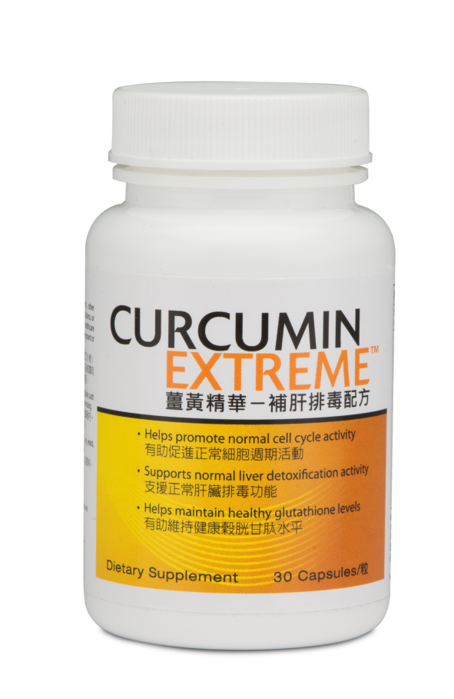
薑黃精華 ─ 補肝排毒配方 Curcumin Extreme™

Slide 3
Liver Functions
http://www.liverfound.org.hk/3_2.htm
The liver is a vital organ promoting metabolism.
The liver is a vital organ that produces coagulation proteins.
Produces:
-Protein
-Blood clotting factors
-Bile
薑黃獲廣泛研究
Without the liver:
- Blood can not clot and wounds won’t stop bleeding
Curcumin has been widely studied
In HK, 600-700 thousands of people suffer from Hepatitis B. 1 million people have fatty liver disease.
Stores:
-Iron
-Vitamins
-Minerals
-Sugars
Liver cancer is the no.3 cancer killer in HK.
The liver is vital to health and life
In HK, 80% liver cancer cases arise from Hepatitis B. The chance of Hepatitis B virus carriers getting liver cancer is 100 times higher.
Around 1/10 people in HK are Hepatitis B virus carriers.
Breaks down:
-Chemical toxins (alcohol, medications)
http://hk.news.yahoo.com/%E9%86%AB%E8%A8%80%E6%9C%89%E7%90%86-%E6%AD%A2%E8%A1%80%E6%9C%80%E5%BE%8C-%E6%AD%A5-%E8%A1%80%E5%87%9D%E5%9B%BA-211858816.html
http://www.am730.com.hk/article.php?article=123377
http://www.am730.com.hk/article.php?article=143590

Slide 4
薑黃精華 ─ 補肝排毒配方 Curcumin Extreme™
或支援肝臟健康
有助維持細胞健康與完整
有助維持健康的穀胱甘肽水平
隨年紀增長支援認知健康
提供抗氧化功能
May support liver health
Helps maintain cell health and integrity
Helps maintain healthy glutathione levels
Supports cognitive health as we age
Provides antioxidant support
Code: HK13147 DC$254 SR$355 BV 24

Slide 5
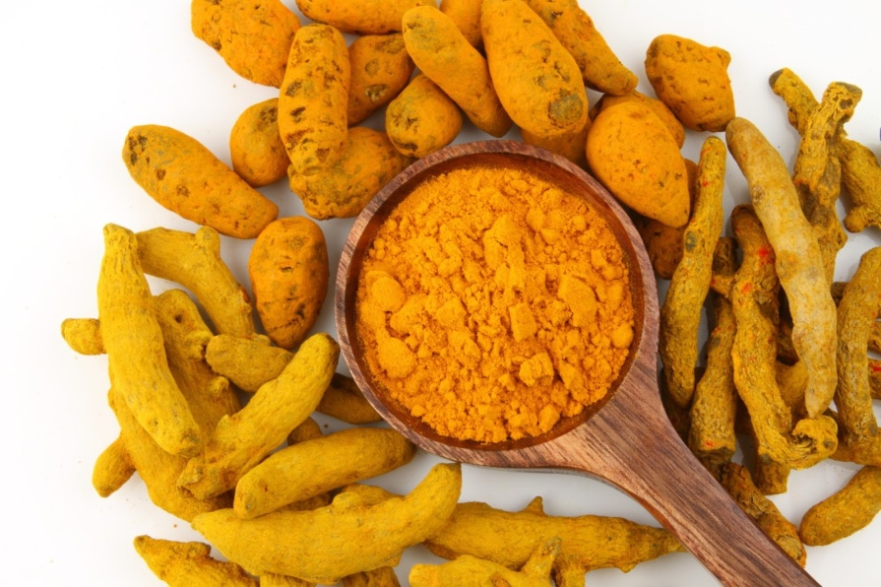
主要成份 Key Ingredients
薑黃素(BCM-95®)
取自薑黃的生物活性成份
BCM-95®代表薑黃根的天然程度，是100%純天然及提供具更高生物可用性的薑黃素，帶來多方面的健康好處
西蘭花籽萃取物（6%蘿蔔硫素）
硒（甲硒胺酸）
Curcumin (BCM-95®)
Represents the natural spectrum of turmeric rhizome
It is 100% natural and delivers a more bioavailable curcumin for a variety of health benefits
Broccoli Seed Extract (6% Sulphoraphanes)
Selenium (Selenomethionine)

Slide 6
薑黃精華 ─ 補肝排毒配方的市場比較
Curcumin Extreme™ Product Comparison
產品名稱 Product | 成份 Ingredients | 價格(每天份量) Total Cost (Serving per day)
薑黃精華 ─ 補肝排毒配方 Curcumin Extreme™ | 薑黃素(BCM-95®) 、 西蘭花籽萃取物及硒 Curcumin (BCM-95®) , Broccoli Seed Extract and Selenium | 11.8
卡士蘭 肝美健 Nu Pharm® Liver • Clear | 花粉精華（超氧化物歧化酶）、酵母精華（谷胱甘肽）及蘆薈精華 Pollen Extract (Superoxide dismutase), Yeast Extract (Glutathione) and Aloe Extract | 42.9
維特健靈 健肝寶 VitaGreen VCM Liver | 雲芝、丹蔘及五味子 Yunzhi, Danshen and Wuweizi | 16.6
2036 靈芝孢子 Ganoderma Lucidum Spores | 赤靈芝孢子 Ganoderma Lucidum Spores | 26.0

Slide 7
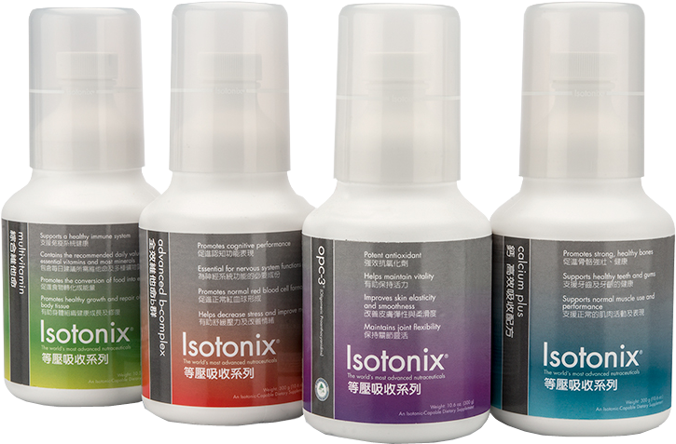
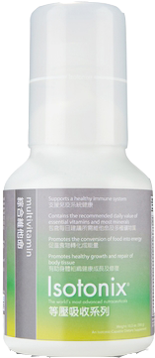
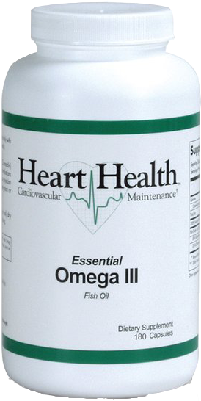
Isotonix®基本營養組合 Isotonix® Daily Essentials Kit
高效營養組合
Optimal Wellness Kit
助你建立健康的基礎
Helping You Form A Healthy Foundation
要擁有最佳的健康，由基本營養開始！
Optimal Health Starts with a Solid Foundation!
Code: HK6475 DC$790 SR$1,100 BV 65
Code: HK6475 HK$820 SR$600 BV 50

Slide 8
組合比較 Kit Comparison
組合 Kit | 產品包括 Products Included | 好處 Benefits |  |  |  |  |  | 適合人士 Suitable for
 |  | 提升能量 Enhance Energy | 抗氧化 Anti-oxidant | 骨骼健康 Bone Health | 提供維他命及礦物質 Provide vitamins & minerals | 穩定 膽固醇Stabilize Cho-lesterol | 心臟健康 Heart Health
Isotonix® 基本營養 組合 Daily Essential Kit | Isotonix OPC-3® Isotonix® 鈣－高效吸收配方 Calcium Plus Isotonix® 全效維他命B群 Advanced B-Complex Isotonix® 綜合維他命 Multivitamin | √ | √ | √ | √ | - | - | 維持基本 營養需要 Maintain a Healthy Foundation
高效營養 組合 Optimal Wellness Kit | Isotonix® 全效維他命B群 Advanced B-Complex Isotonix® 綜合維他命 Multivitamin Heart Health™ 魚油 Essential Omega III | √ | - | - | √ | √ | √ | 提升至 理想健康 Achieve Optimal Health

Slide 9
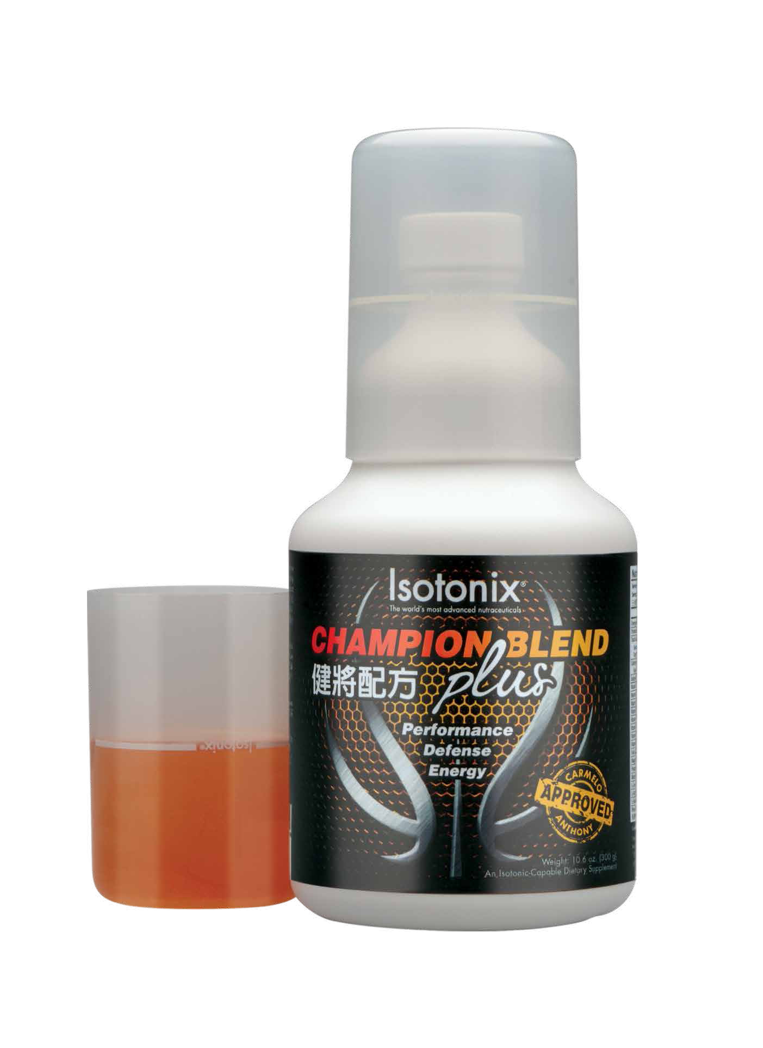
Isotonix®
健將配方
CHAMPION BLEND
plus
籃球巨星Carmelo Anthony
Basketball Superstar Carmelo Anthony
Notes:
In total there are nine essential amino acids, but, BCAAs account for 35% of all the essential amino acids found within muscle protein. They are needed for protein building and can be metabolised and used as an energy source during aerobic exercise. BCAAs are present in all protein rich foods, but are found in the greatest amounts in red meat and dairy products. Whey protein contains particularly high levels of BCAAs.
A reduction in the amount of muscle breakdown, improved preservation of muscle glycogen stores, improved immune health, and a possible improvement in endurance performance. Therefore anyone who trains intensively, wants to recover more quickly from training, increase lean muscle size, reduce muscle soreness, and improve endurance performance may benefit from BCAAs. http://extremebiosciences.com/index.php/nutritional-ingredient-review/72-branch-chain-amino-acids-bcaas
碧容健®松樹皮萃取物
超強抗氧化能力
抗炎功效
速溶支鏈氨基酸
對肌肉成長、保留肌肉非常重要
活性維他命B
提升能量
促進心血管健康
維他命C
促進正常的膽固醇水平和血壓
促進免疫健康
維他命D3
促進骨骼正常形成與生長
促進免疫健康

Slide 10
主要成份 Key Ingredients
碧容健®松樹皮萃取物
速溶支鏈氨基酸
活性維他命B
維他命C
維他命D3
Pycnogenol®
Instantized Branch Chain Amino Acids
Activated B Vitamins
Vitamin C
Vitamin D3
Code: HK13989 DC$412 SR$580 BV 40
Notes:
In total there are nine essential amino acids, but, BCAAs account for 35% of all the essential amino acids found within muscle protein. They are needed for protein building and can be metabolised and used as an energy source during aerobic exercise. BCAAs are present in all protein rich foods, but are found in the greatest amounts in red meat and dairy products. Whey protein contains particularly high levels of BCAAs.
A reduction in the amount of muscle breakdown, improved preservation of muscle glycogen stores, improved immune health, and a possible improvement in endurance performance. Therefore anyone who trains intensively, wants to recover more quickly from training, increase lean muscle size, reduce muscle soreness, and improve endurance performance may benefit from BCAAs. http://extremebiosciences.com/index.php/nutritional-ingredient-review/72-branch-chain-amino-acids-bcaas
碧容健®松樹皮萃取物
超強抗氧化能力
抗炎功效
速溶支鏈氨基酸
對肌肉成長、保留肌肉非常重要
活性維他命B
提升能量
促進心血管健康
維他命C
促進正常的膽固醇水平和血壓
促進免疫健康
維他命D3
促進骨骼正常形成與生長
促進免疫健康

Slide 11
Isotonix® 健將配方
CHAMPION BLEND
plus
表現 – 速溶支鏈氨基酸保留肌肉，有助提升運動表現
防禦 – 強效抗氧化物的碧容健®有助對抗自由基，促進最理想的免疫功能
能量 – 多種活性維他命B可更快被人體利用，因而提升效用
Performance – Instantized Branch Chain Amino Acids promote muscle retention and help benefit the performance of active adults
Defense – Antioxidant Pycogenol® helps combat free radicals and promote optimal immune functions
Energy – Activated B vitamins are more readily processed by the body and thereby increase their effectiveness
集表現、防禦、能量於一身 ─ 健將之選
Performance, Defense, Energy –
the perfect recipe of champions

Slide 12
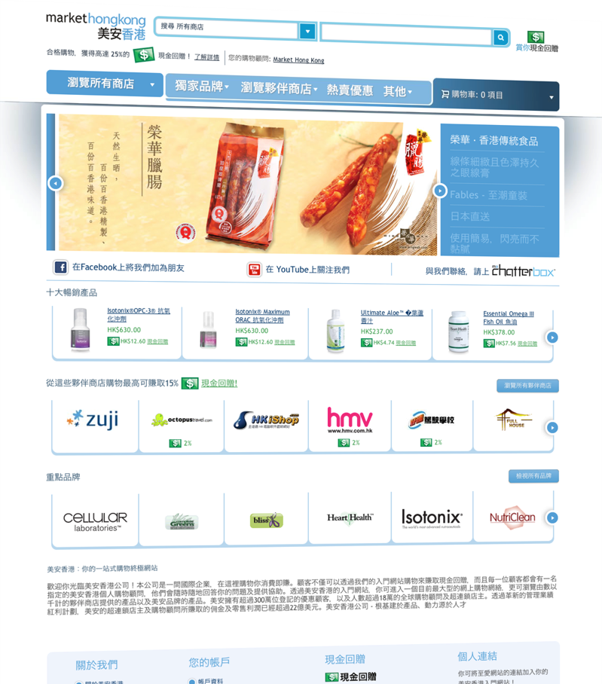
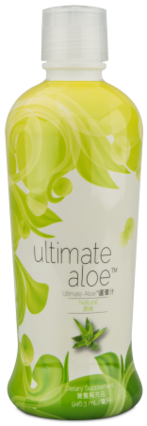
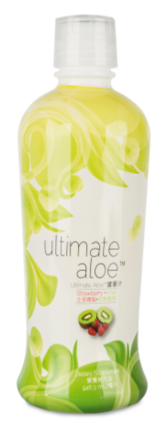
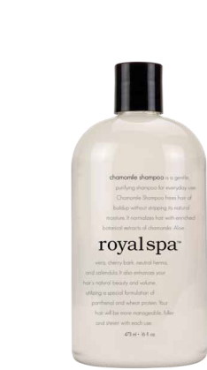
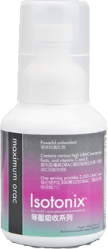
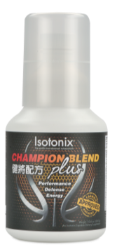
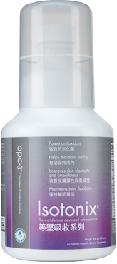
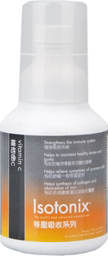
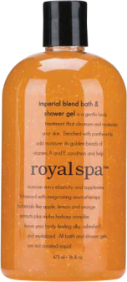
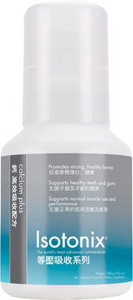
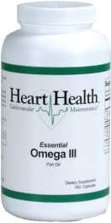
快速起步套裝
Fast Start Program
只需HK$3,237即可開展事業
Start your business for only HK$3,237
免費送貨
Free Delivery
超過OVER
HK$5,000 的價值VALUE
包括
HK.SHOP.COM網站‧超連鎖™店主資格（300BV及3個商業發展中心）
入門資料套裝‧美安香港精選產品套裝‧事業建立支援工具
CONTAINS
HK.SHOP.COM website ∙ UnFranchise™ Business (300 BV & 3 BDCs)
Subscription Kit with selected mhk brands ∙ Business-building materials

Slide 13
Isotonix®資料冊 Isotonix® Booklet

Slide 14
Isotonix®資料冊 Isotonix® Booklet
提供
Isotonix的科學原理
產品特性、優勢和好處
針對性的配方
Provides
Science behind Isotonix
Product features, advantages and benefits
Specialized formulation
Code: HK161 DC$50
(10本裝/ Pack of 10)

Slide 15
Isotonix®的科學原理 The Science behind Isotonix

Slide 16
產品特性 Product Properties

Slide 17
針對性的配方 Specialized Formulation

